Slide 1
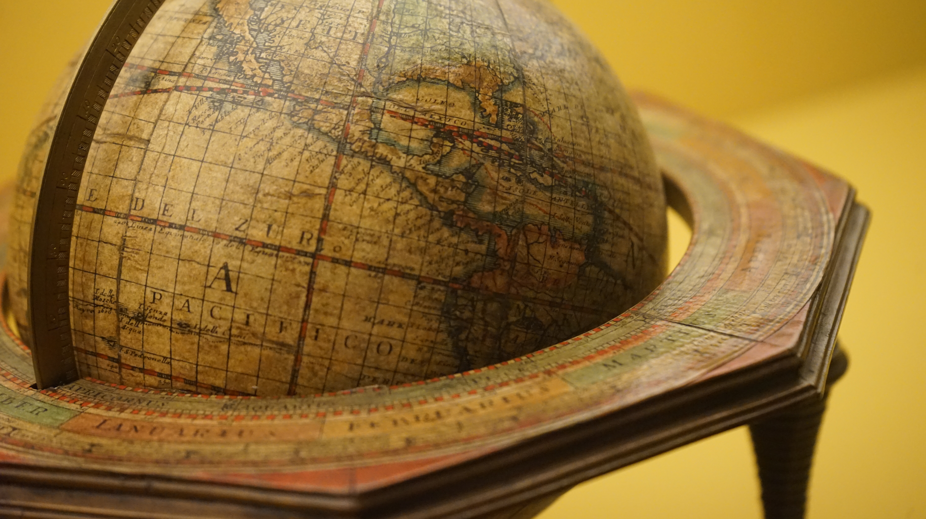
Astronomy 100 Lab 4
Yvonne Ban
Globenmuseum, Österreichische Nationalbibliothek
Vienna, Austria
21 Oct 2017
COVID REMINDERS: Your face mask must cover your mouth AND nose.
If you are feeling at all ill, email your instructor, and don’t come to lab unless you have gotten a negative test.
Spring 2022

Slide 2
Fill out the Pre-Lab 4 survey on Moodle.
We will offer makeup labs for Lab 3 (Wed) and 4 (Fri) next week. You can also come for help with DIY labs.
You will be working as a team at each table. Decide on your roles for Part 1.
Make sure everyone participates in the observation.
Have people at table begin recording dimensions and calculating right away. Don't wait to collect all the measurements or you'll run out of time.
If you do not do numerical work for Part 1, make sure you do it for Part 2.
If you have a large group, you can repeat and check each other’s calculations.
Fill in your table number, names, and roles on the table worksheet.
Also be sure to mark your table number on the end-of-lab quiz or you may not receive credit!

Slide 3
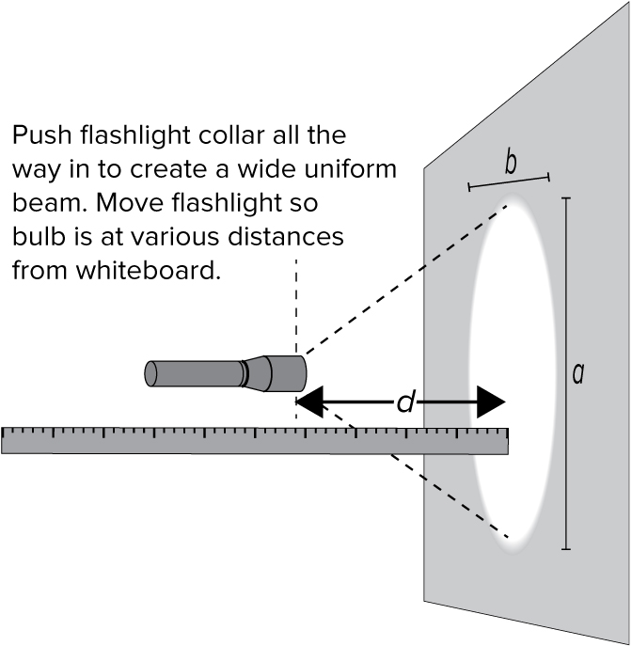
Part 1: Near, far, wherever you are
Push the flashlight collar all the way in.
Point it at the whiteboard from 0.5 feet away i.e. d on the diagram
Turn the flashlight on. Decide as a group where the edge of the beam is and trace it on the board.
Measure the height and width of the beam (a and b).

Slide 4
Part 1: Near, far, wherever you are
Repeat the measurements at:
1.0' ii. 1.5' iii. 2.0'
Some possible values at 1.0' are written in gray on your worksheet to illustrate the calculations, but you should replace these with your own measurements.
Fill in the table in the first part of the table worksheet.
Plot the points on the grid.
Pick another distance to make a measurement that will help you draw a smooth curve through your points, and add that point to your plot.
a
b

Slide 5
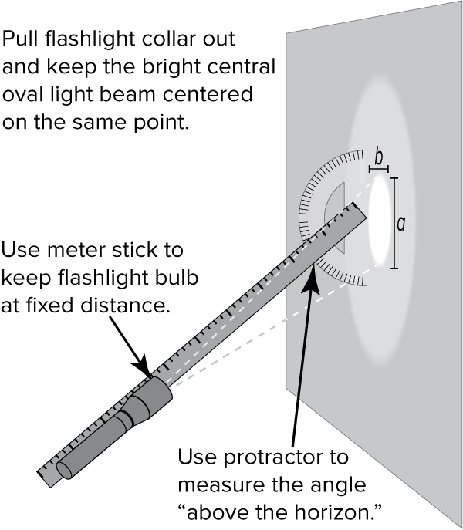
Part 2: I need your love light
Change roles for this experiment and write it down on the table worksheet.
Pull the flashlight collar all the way out.
With the flashlight held at 1.0 foot from the board, pointing at the board at an angle of 90° as measured by the protractor, measure the height (a) and width (b) of the beam, as before.
Use the metre-stick to align the flashlight with the correct angle according to the protractor.

Slide 6
Part 2: I need your love light
a
Repeat the measurements at:
i. 71° ii. 47° iii. 24°
Make sure to measure from the center of the ellipse (where a and b cross).
Fill in the table in the second part of the table worksheet.
Plot the points on the grid.
Pick another angle to try to match your result at 90° and 2.0' previously, and add that point to your plot.
b
protractor here

Slide 7
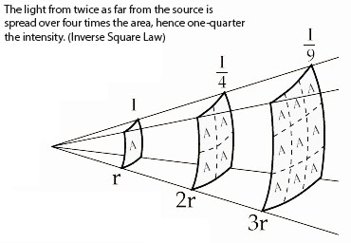
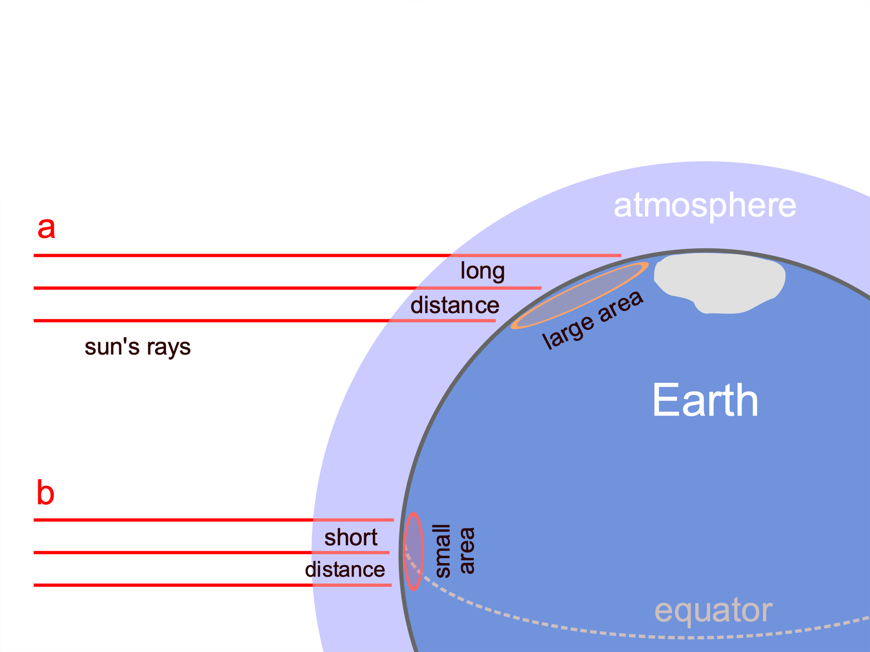
Part 3: Intensity effects
From your table, does intensity increase or decrease with:
distance?
altitude (angle)?
What distance at 90° corresponds to shining the torch from 1 foot away at an altitude of 24°?
Which effect is more important for:
Earth?
a comet?
Mars?

Slide 8
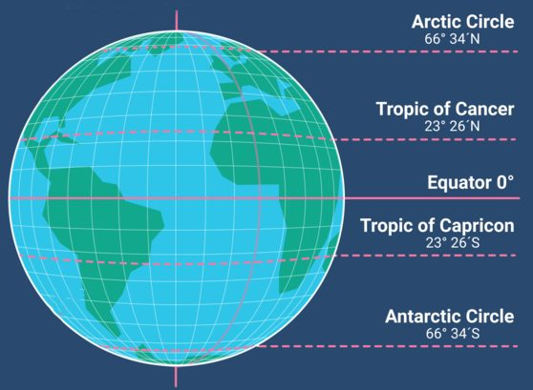
Northern Summer Solstice:
The Sun shines straight down on the Tropic of Cancer, 23.5° North of the equator.
At our latitude at the summer solstice, the Sun’s light is spread over an area almost as small as at the Tropic of Cancer, so the intensity is high and the ground and atmosphere heat most.

Slide 9
Northern Winter Solstice:
The Sun shines straight down on the Tropic of Capricorn, 23.5° South of the equator.
At our latitude at the winter solstice, the Sun’s light is spread over a much larger area, so the intensity is much lower and the ground and atmosphere cool down.
We’re actually a few million kilometers closer to the Sun in January, but that’s a tiny percent change in distance and unimportant!

Slide 10
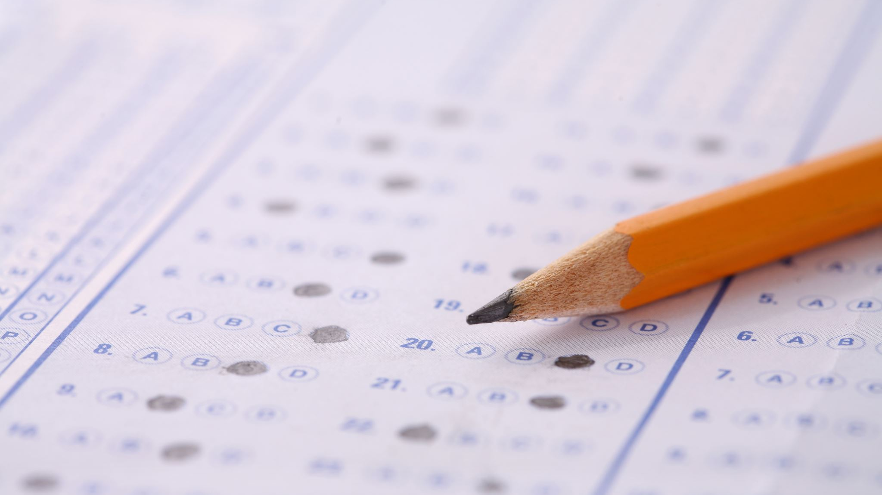
End-of-lab quiz password: nautilus
Turn in your table worksheet! You can take a picture of it first for future reference.

